Slide 1

CityView360 A Real-Time Urban Complaint and Resolution Platform
Batch Members
AMOGH VIJAY - 24CS0053
NAVDEEP R - 24CS0584
Notes:
JOURNAL
2023-25
1)IEEE
2)ELS
3_GOOGLE SCHOLAR

Slide 2

PROBLEM STATEMENT
Urban areas are facing increasing challenges in managing public utilities such as water, electricity, sanitation, and waste disposal. While citizens frequently report issues, these complaints are often scattered across various platforms and go unanalyzed in real time. This leads to delayed responses, inefficient resource allocation, and growing public dissatisfaction.

Slide 3
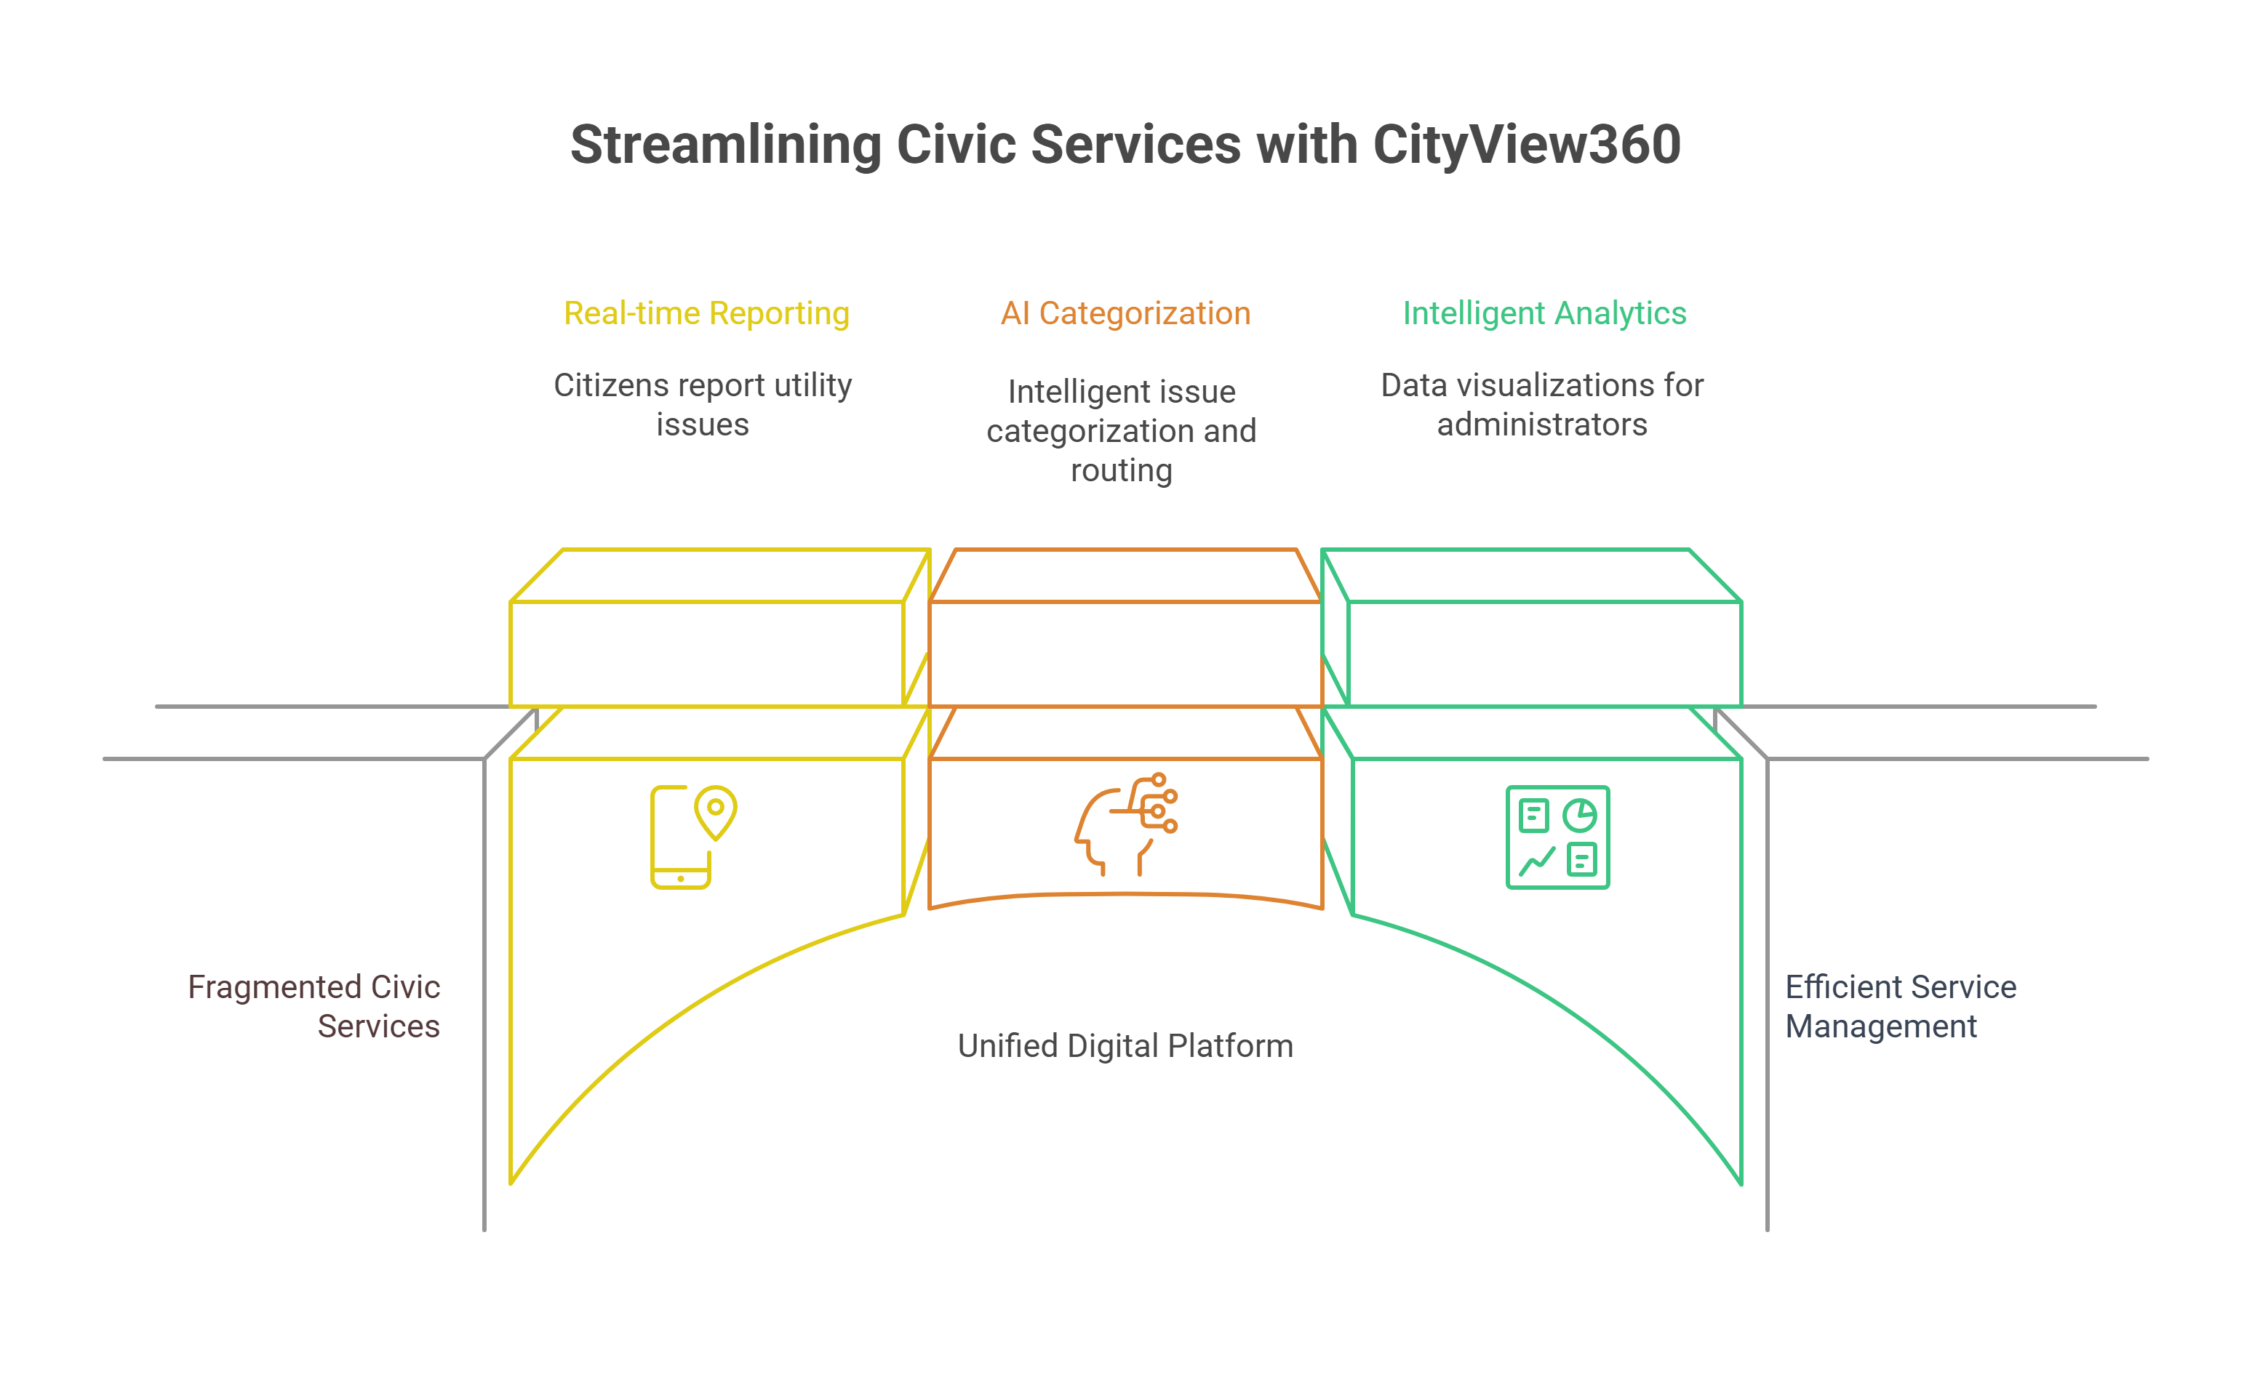
AIM AND SCOPE
“Our solution aims to create a web-based, AI-powered platform that lets citizens easily report and track public utility issues in real time, while helping authorities monitor trends, prioritize actions, and improve services through intelligent analytics.”
Scope:
Web-based multi-format complaint reporting
Transparent ticket tracking and resolution
Automated categorization and geo-tagging
AI dashboards for issue prioritization
Dynamic heatmap visualization of trends
Smart escalation of unresolved cases
Future machine learning for predictive insights

Slide 4
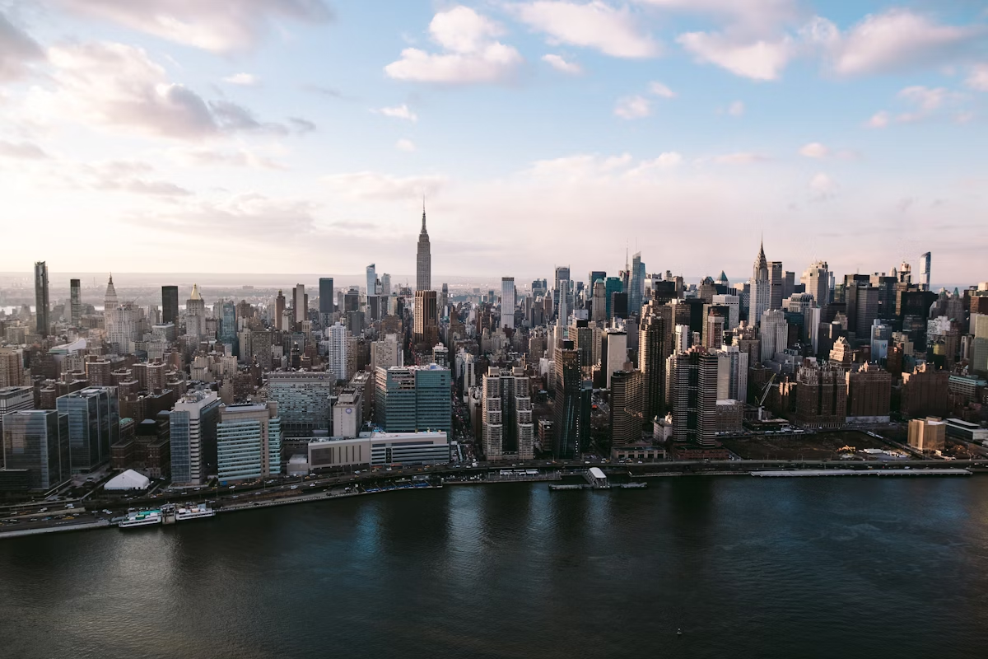
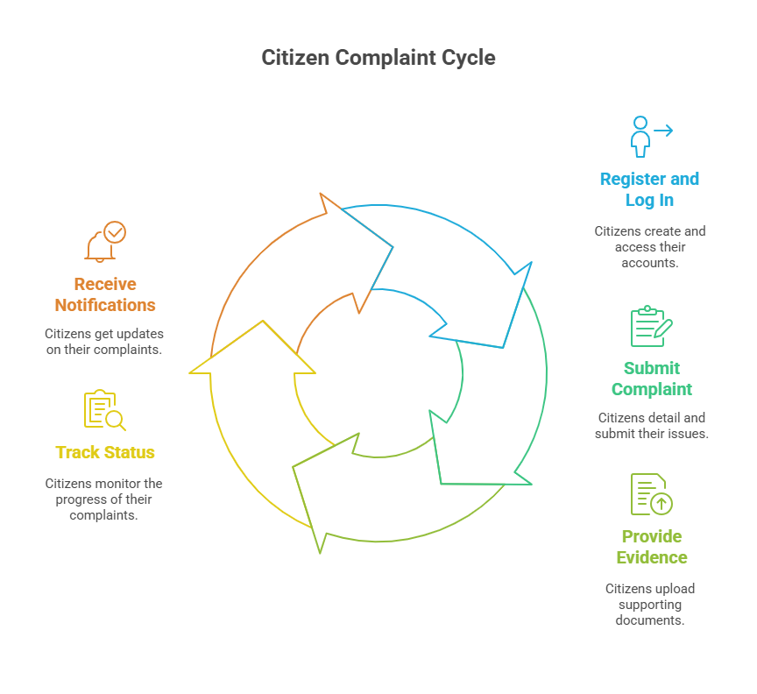
User Complaint Timeline

Slide 5
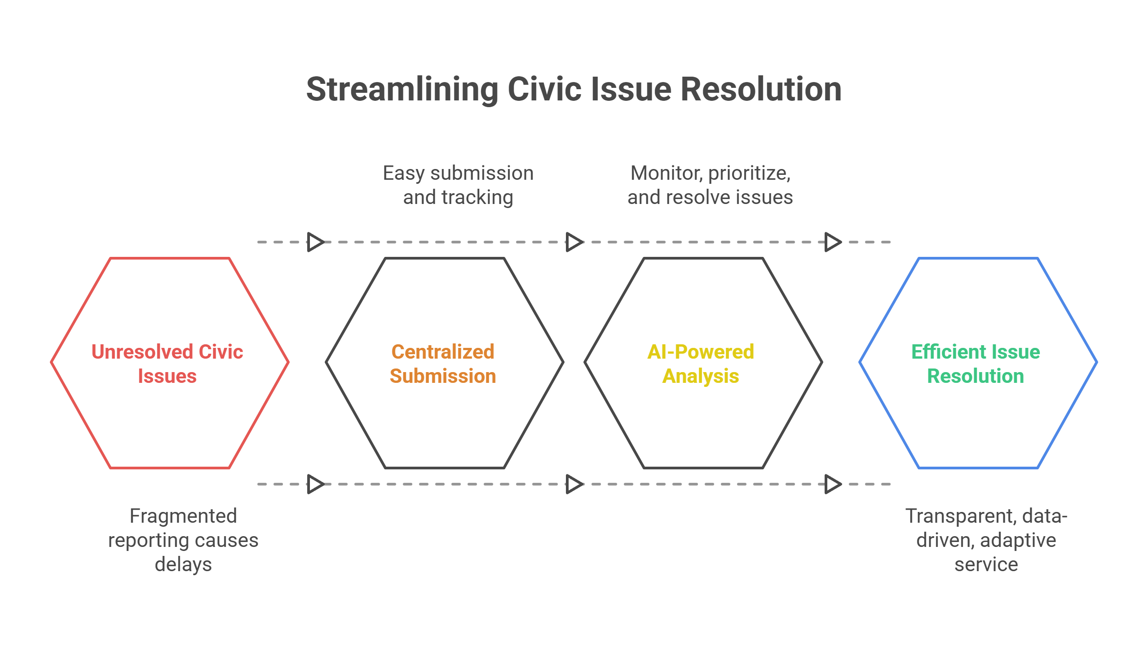

Slide 6
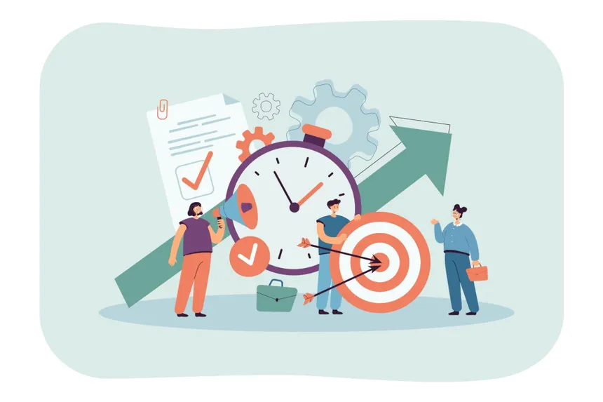
PROPOSED BLOCK DIAGRAM
Citizens: Register/login, submit complaints, upload proof, track status, and receive notifications.
Chatbot:
Assists with generating a hidden complaint form, allows optional data like geotagging. Ensuring Elegant Interface. Interacts with ticket to track status.
Complaint Submission:
Categorizes (e.g., sanitation, infrastructure, safety) by keywords and AI-assisted tagging. Severity scale (Low / Medium / High / Critical) based on prioritization.
Database:
Stores all unresolved complaint reports and their data. Also stores Historical Data of closed complaints.
Complaint Resolution:
Resolved Complaints are closed. Historical data is saved for recommending optimal solutions
Officials:
Use Dashboard with real-time complaint tracking, prioritization tools, and resolution updates. To effectively divide and assign responsibilities
Dashboard / Tools:
Displays Analysis results using various charts. Helps identify affected zones with heatmaps and severity scale-based color coding
Analytics:
Based on grouped data, analyses the validity, potential impacts of each complaint, and identifies the root cause of grouped complaints.
Administrators: Oversee complaint trends, escalation handling, and performance analytics.

Slide 7
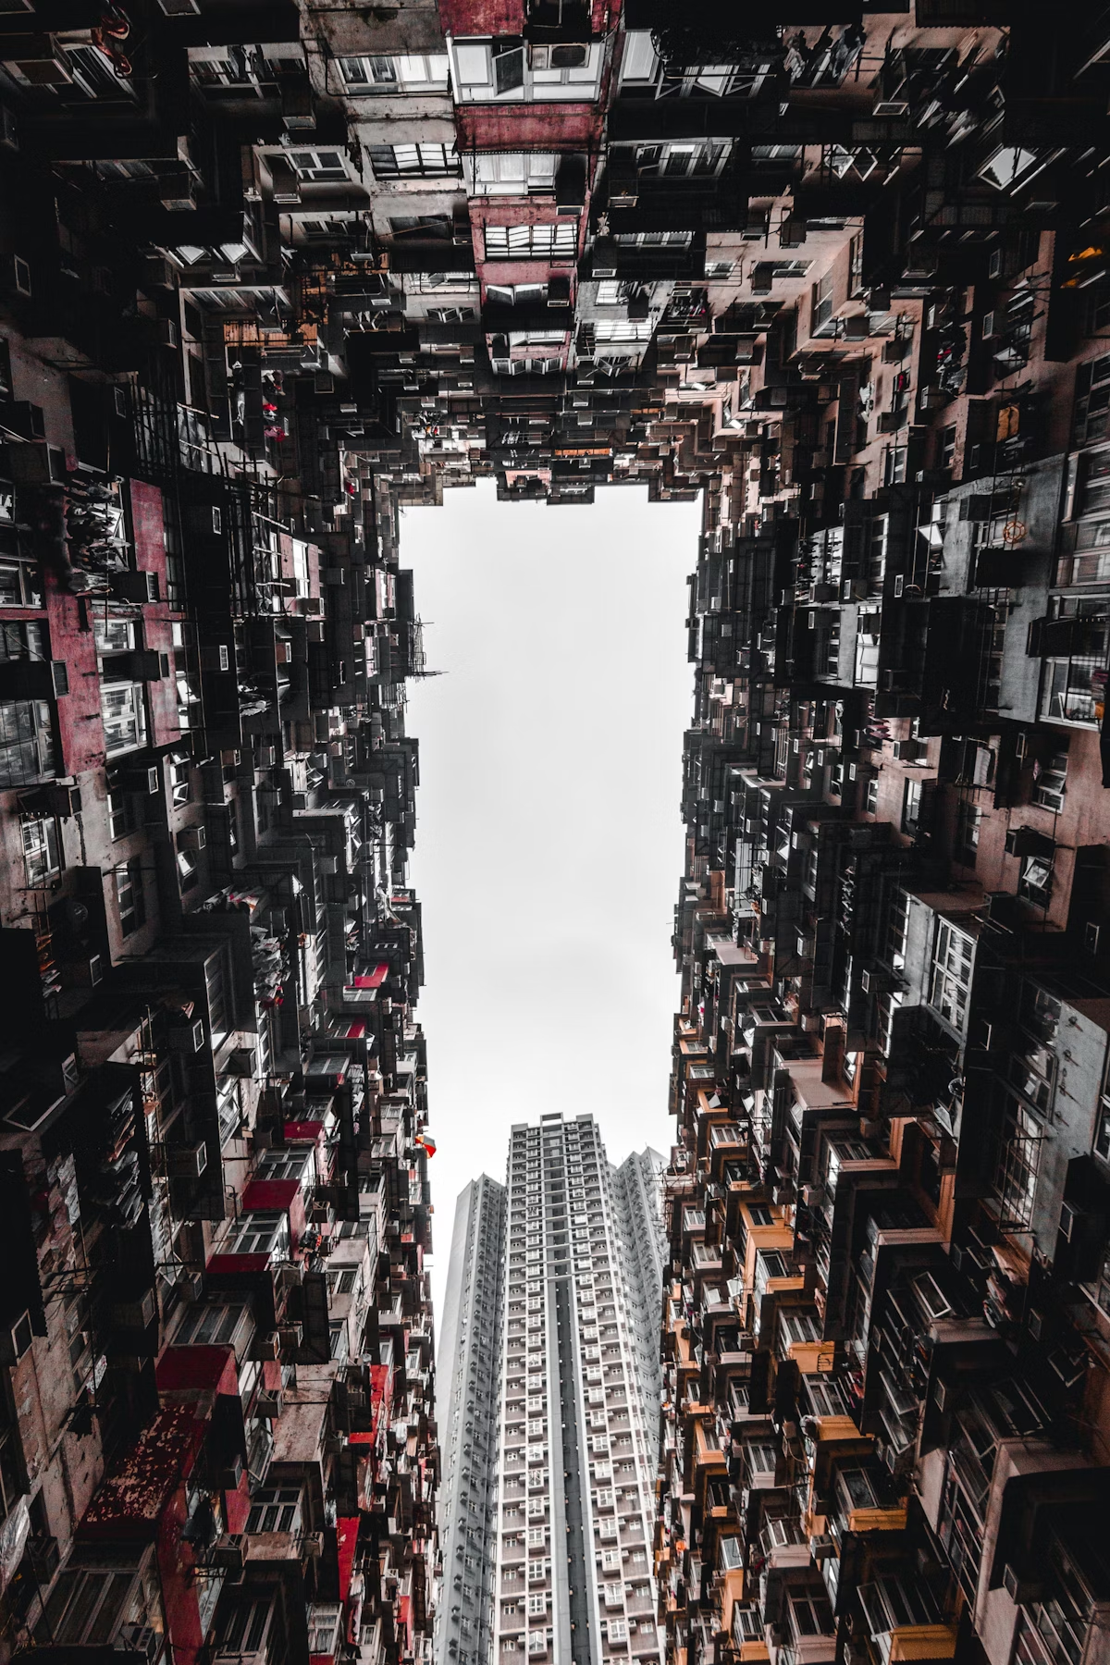
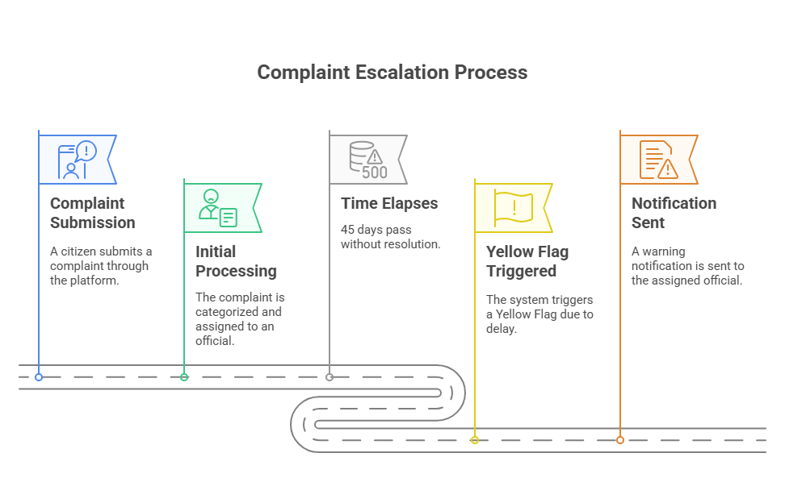
Complaint Escalation Process

Slide 8
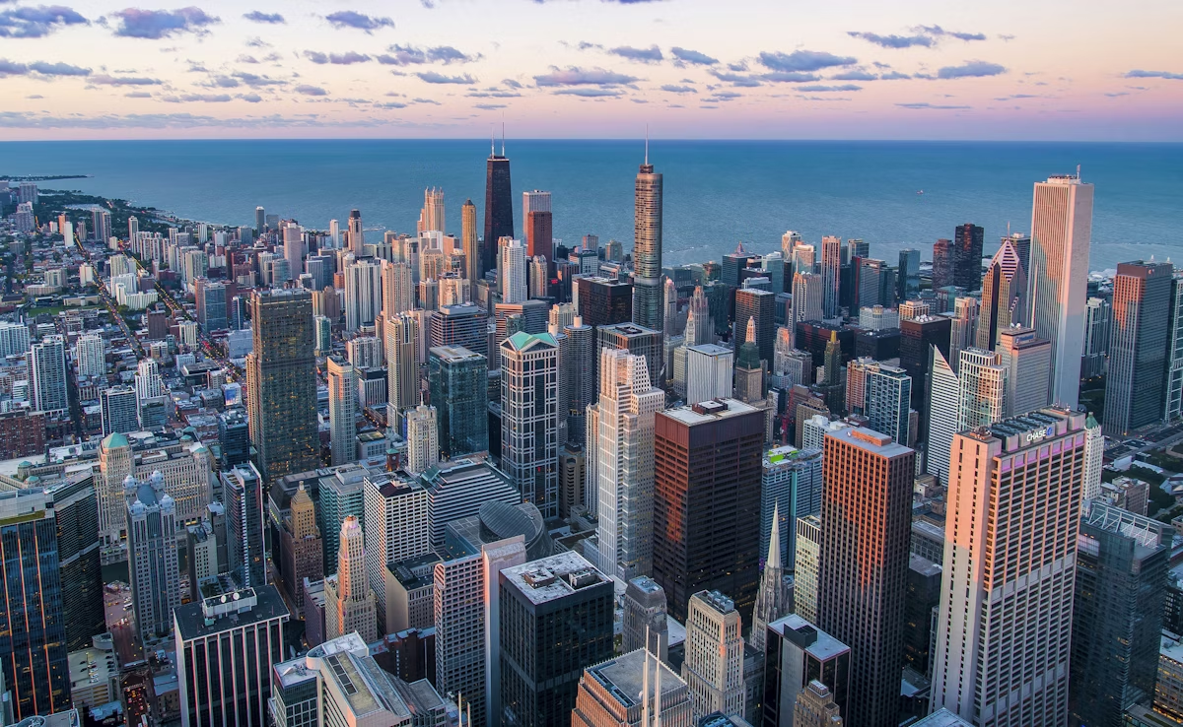
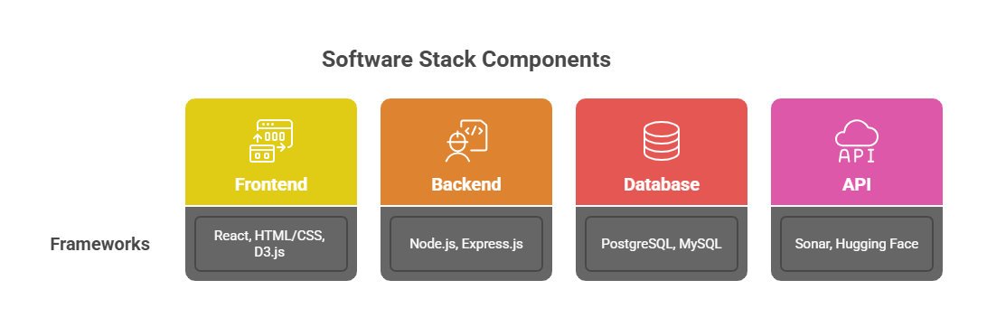
Implementation

Slide 9
